Slide 1
EN 55014:2001+A1

Slide 2
Scope:
Being applicable to the conduction and radiation of RFD from the appliance whose main functions are performed by motors, switching and regulating devices, unless RF energy is intentionally generated or intentionally generated or intend for illumination.
e.g.: household electrical appliances, electric tools. Regulating controls using semiconductor devices, motor-driven electro-medical apparatus, electric toys. Automatic dispensing machines as well as cine or slide projectors.
also included in the scope of this standard are:
separated part of the above mentioned have no emission requirements apply.

Slide 3
Scope:
B. No requirements for apparatus that cannot be measured in the
test site.
C. Excluded from the scope of this standard are
the RF range is explicitly formulated in other IEC or CISPR standards.
Luminaires, lamp etc. CISPR 15;
AV CISPR 13;
Mains communication devices: IEC 61000-3-8;
Microwave oven, RF energy for heating and therapy purpose:CISPR 11
IT CISPR 22
Electric equipment used in motor vehicles: CISPR 12

Slide 4
Scope:
8) Regulating control incorporated with semiconductor with
rated input current of more than 25A per phase.
9) Stand-alone power supplies
D frequency range: 9kHz~400GHz;
E Multifunction equipment simultaneously to different clauses
of different standard with relevant function in operation.

Slide 5
Definitions:
Weighting
Upper quartile method:

Slide 6
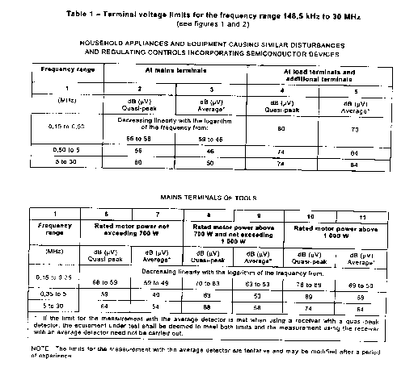
The limit of disturbance:
Continued disturbance:

Slide 7
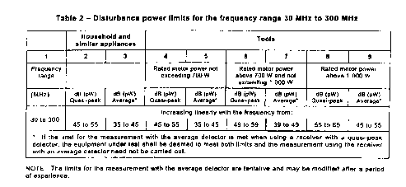
Continued disturbance limit:

Slide 8
Discontinuous disturbance:
Using QP detector
N=n*f/T
Frequency range:148.5kHz to 30MHz.
Lq= L+44 for (N<0.2)
L+20lg(30/N)dB for (0.2<N<30)
Exceptions from the click definition
Individual switching operations
Combination of clicks in a time frame less than 600ms: once per selected programme cycle or once during the minimum observation time and for thermostatically controlled three-phase switches.
Instantaneous switching
For N <5, the separation of two disturbances is less than 200ms is two clicks.

Slide 9
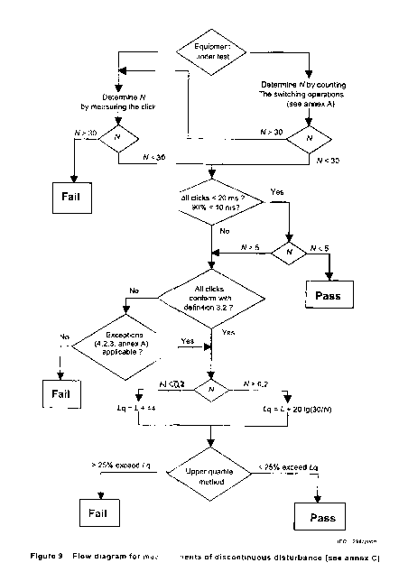
Discontinuous disturbance:

Slide 10
Method of terminal disturbance:
Measuring devices: (for the detail, pls refer to CISPR 16-1)
Measuring receivers
Setup:
pre-scan: 0.15~30mHz; step 5khz; IF band 9kHz; measure time 10ms
atten 10dB; preamp OFF: measure range 60dB; detector PK;
Final-scan: detector QP+AV; measure time 1S; points 8;
Artificial main network
Voltage probe
Artificial hand
Disturbance analyzer for discontinuous disturbance

Slide 11
Method of terminal disturbance:
Measuring procedure and arrangements:
Arrangement of the leads of the equipment under test
Mains lead
other leads
Disposition of appliances under test and their connection to the artificial mains V-network
Appliances normally operated without an earth connection and not held in the hand;
Handheld appliances which are normally operated without an earth connection;
Appliance normally required to be operated with an earth connection.

Slide 12
Method of terminal disturbance:
Measuring procedure and arrangements:
Appliances having auxillary apparutus connected at the end of a lead other than the mains lead
If have the following case, the test have no need to do:
permanently fixed at both ends;
shorter than 2m
shielding and ends is connected to the metal housing of the appliance and that of the auxiliary apparatus
Measuring arrangement
Measuring procedure
Regulating controls incorporating semiconductor devices;
Reduction of disturbance not produced by the equipment under test.

Slide 13
Method of disturbance power:
Measuring devices:
Measuring receivers
Setup:
pre-scan: 30~300mHz; step <80khz; IF band 120kHz; measure time 10ms
atten 10dB; preamp OFF: measure range 60dB; detector PK;
Final-scan: detector QP+AV; measure time 1s or 15s; points 8;
Absorbing clamp

Slide 14
Method of disturbance power:
Measuring procedure on the mains lead;
Special requirements for appliances having auxiliary apparatus connected at the end of a lead other than the mains leads

Slide 15
Operation conditions and interpretation of result:
General:
Normal load;
The duration of operation;
No running-in time to be specified but;
Rated voltage and rated frequency of the appliance;
Speed control;
Ambient temperature.

Slide 16
Operation conditions and interpretation of result:
Operating condition for particular equipment:
Multifunction equipment;
Battery operated equipment;
Integrated starting switched, speed controls, etc( N! );
Thermostats(if not specified, N=10 );
Regulating controls incorporating semiconductor devices;

Slide 17
Operation conditions and interpretation of result:
Standard operating condition and normal load:
Motor-operated appliance;
Electric tools;
Motor-operated electromedical apparatus;
Electrical heating appliances;
Automatic goods-dispensing machines, entertainment machines ;
Electrical toys running on tracks;
Miscellaneous equipment and appliances;

Slide 18
Operation conditions and interpretation of result:
Interpretation of result:
Continuous disturbance;
Discontinuous disturbance;

Slide 19
FOR INSTANCE:
Commutator if have narrowband interference:
Pay great attention to AV measurements

